Slide 1
Optical Fiber Communication ICE-3241
Dr. Md. Hasnat Kabir
Dept. of Information and Communication Engineering,
University of Rajshahi,
Rajshahi, Bngladesh.
08-08-2017
Ref: Optical Fiber Communications
Principles and Practice
JOHN M. SENIOR

Slide 2
Definition
Fiber-optic communication is a method of transmitting information from one place to another by sending pulses of light through an optical fiber.
The light forms an electromagnetic carrier wave that is modulated to carry information.
Optical fiber is used by many telecommunications companies to transmit telephone signals, Internet communication, and cable television signals.
https://en.wikipedia.org/wiki/Fiber-optic_communication

Slide 3
Comparison with electrical transmission
Depend on applications.
Optical fiber is generally chosen for systems requiring higher bandwidth or spanning longer distances than electrical cabling can accommodate.
The main benefits of fiber are its exceptionally low loss.
Its inherently high data-carrying capacity.
Thousands of electrical links would be required to replace a single high bandwidth fiber cable.
Fiber cables experience effectively no crosstalk, in contrast to some types of electrical transmission lines.
Fiber can be installed in areas with high electromagnetic interference (EMI), such as alongside utility lines, power lines, and railroad tracks.
https://en.wikipedia.org/wiki/Fiber-optic_communication

Slide 4
Working principle
Total Internal Reflection
When a ray of light travels from a denser to a rarer medium such that the angle of incidence is greater than the critical angle, the ray reflects back into the same medium this phenomena is called total internal reflection.
In the optical fiber the rays undergo repeated total number of reflections until it emerges out of the other end of the fiber, even if the fiber is bent.

Slide 5
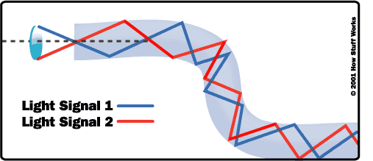
Total internal reflection in optical fiber

Slide 6

How fiber works?

Slide 7
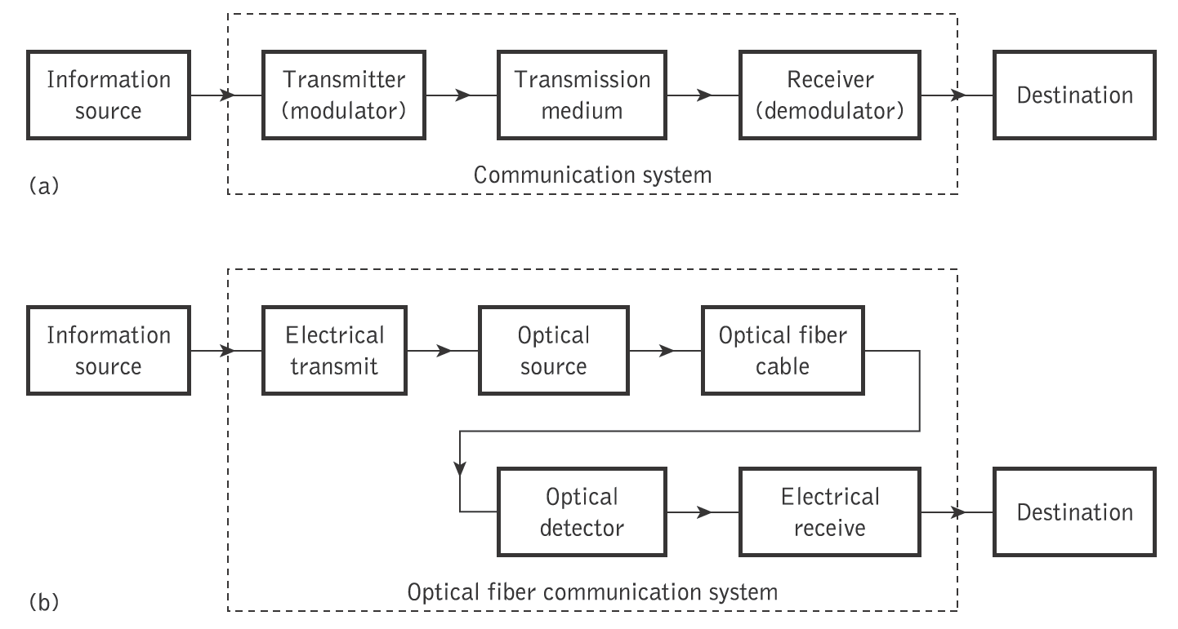
The general system
An optical fiber communication system is similar in basic concept to any type of communication system.
A block schematic of a general communication system is shown in Figure 1.2(a),

Slide 8
Information source- it provides an electrical signal to a transmitter comprising an electrical stage.
Electrical transmitter- It drives an optical source to give an modulation of the light wave carrier.
Optical source- It provides the electrical-optical conversion .It may be a semiconductor laser or an LED.

Slide 9
Optical cable: It serves as transmission medium.
Optical detector: It is responsible for optical to electrical conversion of data and hence responsible for demodulation of the optical carrier. It may be a photodiodes, phototransistor, and photoconductors.
Electrical receiver: It is used for electrical interfacing at the receiver end of the optical link and to perform the signal processing electrically.
Destination: It is the final point at which we receive the information in the form of electrical signal.

Slide 10
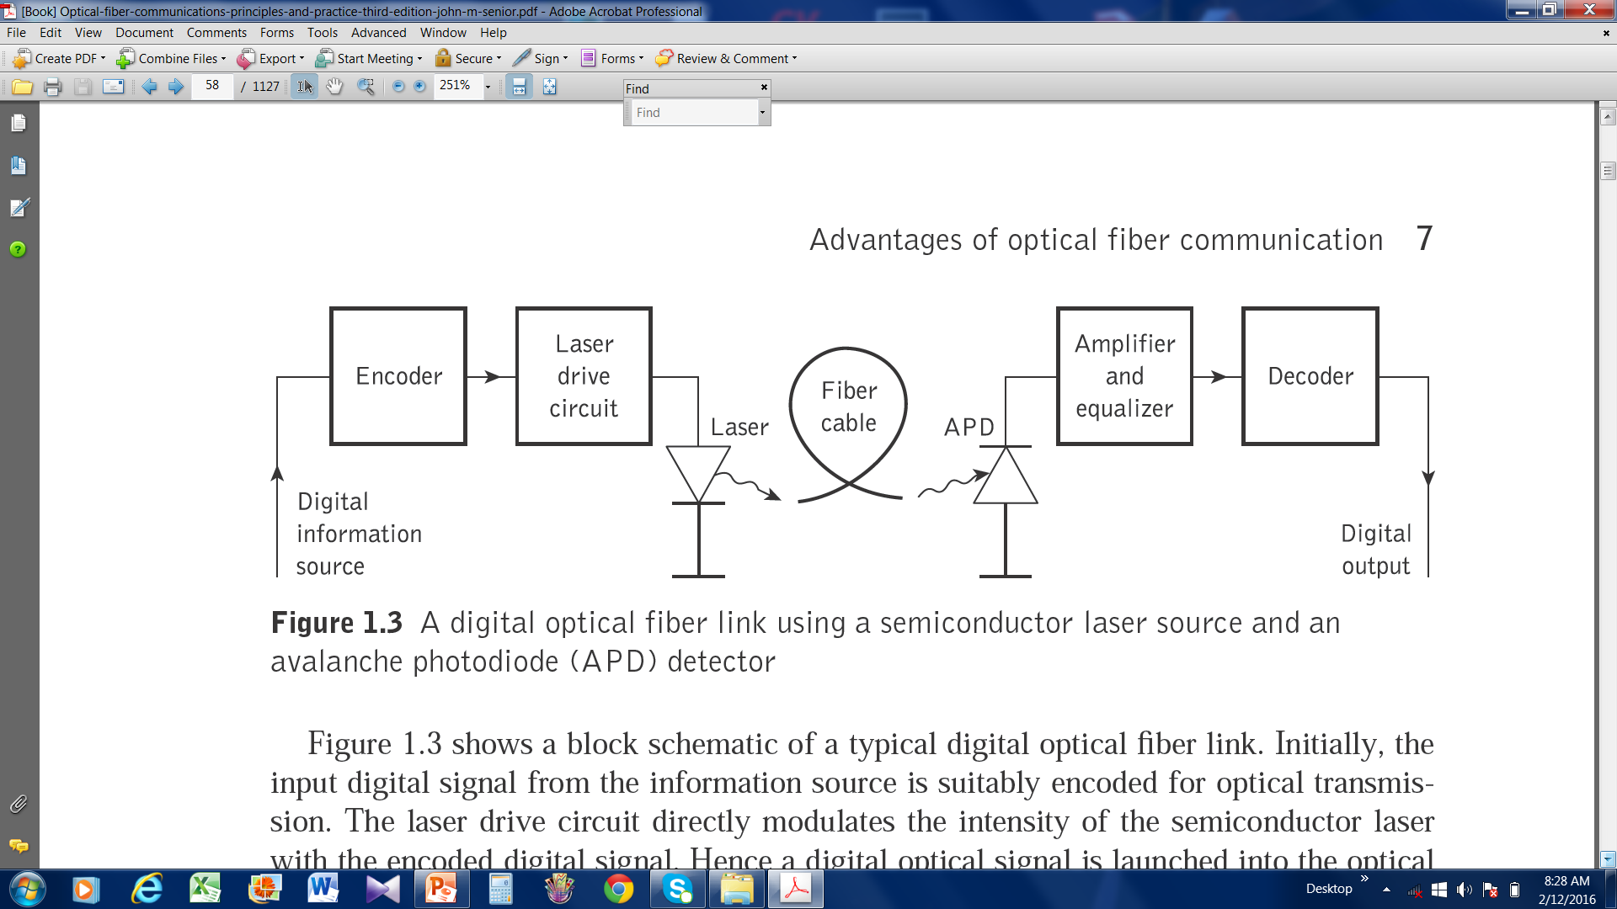

Slide 11
Advantages of optical fiber communication
(a) Enormous potential bandwidth: The optical carrier frequency in the range 10¹³ to 10¹⁶ Hz yields; >> metallic cable systems or even millimeter wave radio systems.
(b) Small size and weight: small diameters < diameter of a human hair.
Therefore it is useful for such as aircraft, satellites and even ships.

Slide 12
(c) Electrical isolation: electrical insulators and therefore, do not exhibit interface problems.
Transmission ideally suited for communication in electrically hazardous environments.
(d) Immunity to interference and crosstalk: Optical fibers form a dielectric waveguide and are therefore free from electromagnetic interference (EMI), radio-frequency interference (RFI).
Hence the system is unaffected by transmission through an electrically noisy environment and the fiber cable requires no shielding from EMI.
Moreover, there is no optical interference between fibers and hence, crosstalk is negligible.

Slide 13
(e) Signal security: The light from optical fibers does not radiate significantly and therefore they provide a high degree of signal security.
(f) Low transmission loss: It exhibits very low attenuation or transmission loss in comparison with the best copper conductors.
Fibers have been fabricated with losses as low as 0.15 dB km⁻¹ and this feature has become a major advantage of optical fiber communications.
(g) Ruggedness and flexibility: The fibers may be bent to quite small radii or twisted without damage.

Slide 14
(h) System reliability and ease of maintenance: the low-loss property of optical fiber cables reduces the requirement for intermediate repeaters or line amplifiers to boost the transmitted signal strength.
(i) Potential low cost: made from sand, potential for low-cost line communication.
Bulk purchase has become competitive with copper wires.

Slide 15
Disadvantage
Highly skilled staff would be required for maintenance
Only point to point working is possible on optical fiber
Precise and costly instruments would be required
Costly if under utilized.
Accept unipolar codes only.
Jointing of fiber and splicing is also time consuming.

Slide 16
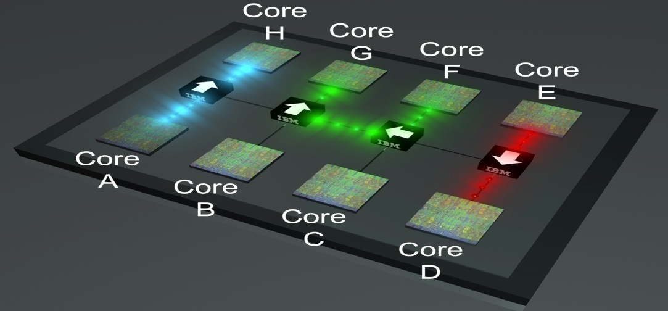
Applications
Optical fiber have wider range of application in almost all field, some are been specified below
In telecommunication field
In space applications
Broadband applications
Computer applications industrial applications
Mining applications
In medical applications
In military applications etc.

Slide 17
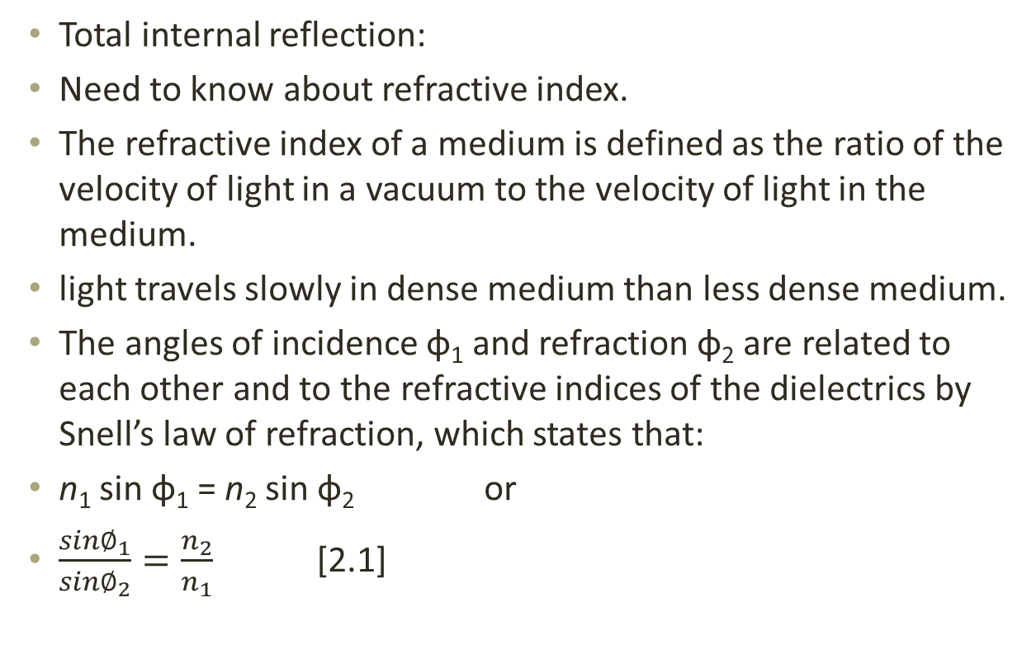
Ray theory transmission
Total internal reflection:
Need to know about refractive index.
The refractive index of a medium is defined as the ratio of the velocity of light in a vacuum to the velocity of light in the medium.
light travels slowly in dense medium than less dense medium.
The angles of incidence φ₁ and refraction φ₂ are related to each other and to the refractive indices of the dielectrics by Snell’s law of refraction, which states that:
n₁ sin φ₁ = n₂ sin φ₂ or
$\frac{{sin∅}_{1}}{{sin∅}_{2}}=\frac{n_{2}}{n_{1}}$ [2.1]

Slide 18
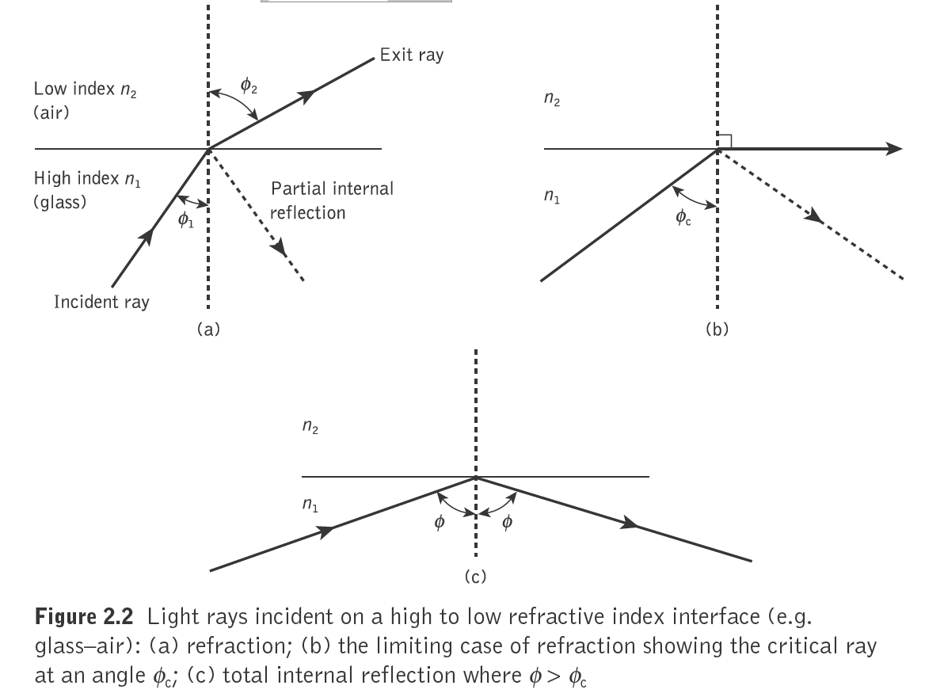

Slide 19
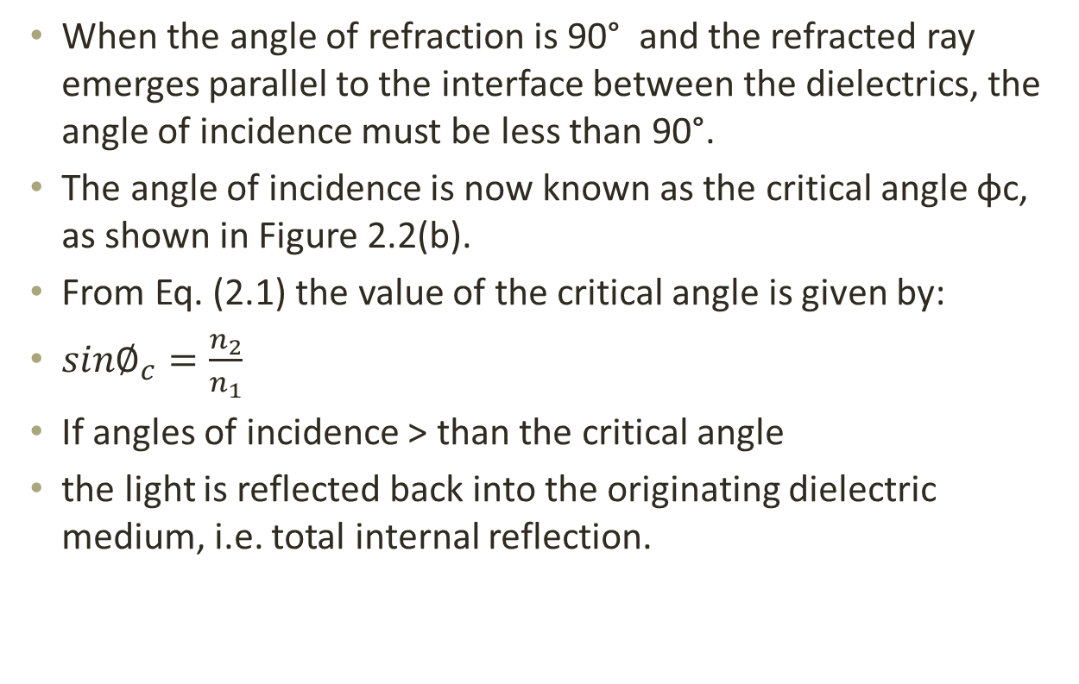
When the angle of refraction is 90° and the refracted ray emerges parallel to the interface between the dielectrics, the angle of incidence must be less than 90°.
The angle of incidence is now known as the critical angle φc, as shown in Figure 2.2(b).
From Eq. (2.1) the value of the critical angle is given by:
${sin∅}_{c}=\frac{n_{2}}{n_{1}}$
If angles of incidence > than the critical angle
the light is reflected back into the originating dielectric medium, i.e. total internal reflection.

Slide 20
This is the mechanism of propagating light via an optical fiber with low loss.
Figure 2.3 illustrates the transmission of a light ray in an optical fiber via a series of total internal reflections
The ray has an angle of incidence φ at the interface which is greater than the critical angle and is reflected at the same angle to the normal.

Slide 21
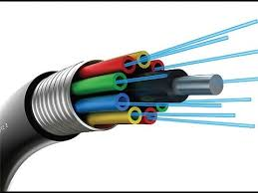
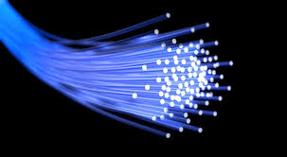
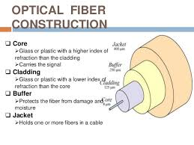

Slide 22
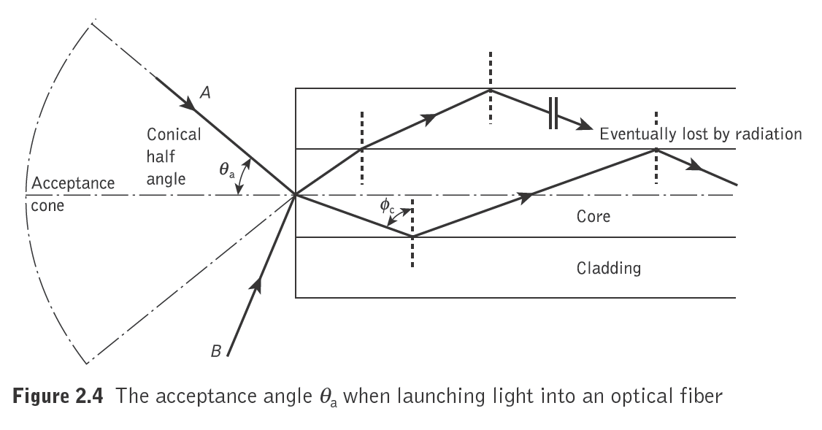
Acceptance angle
For transition of light by total internal reflection within the fiber core, light must be incident on the fiber core within an acceptance cone defined by the conical half angle θ_{a}.
Hence θ_{a} is the maximum angle to the axis at which light may enter the fiber in order to be propagated, and is often referred to as the acceptance angle for the fiber.

Slide 23
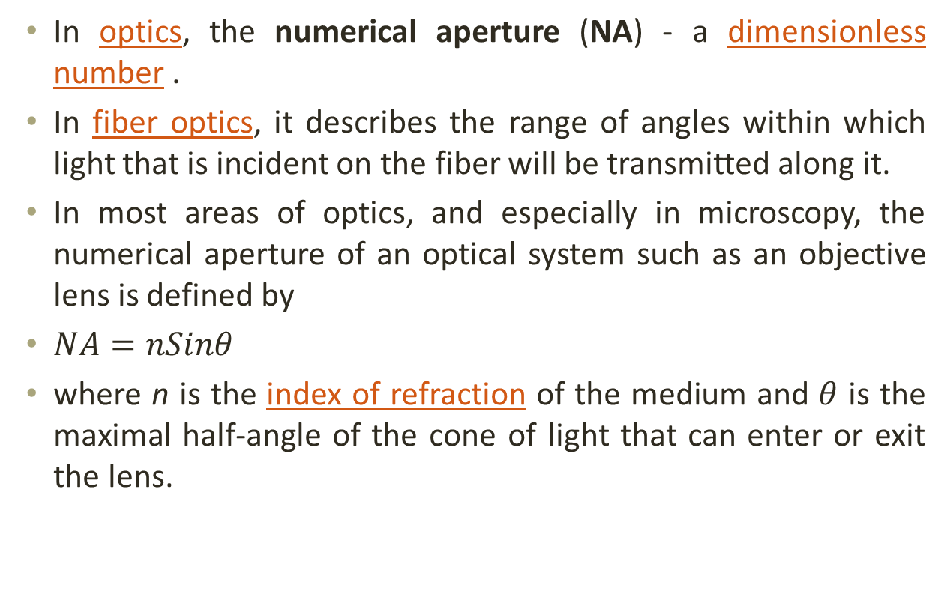
Numerical Aperture
In optics, the numerical aperture (NA) - a dimensionless number .
In fiber optics, it describes the range of angles within which light that is incident on the fiber will be transmitted along it.
In most areas of optics, and especially in microscopy, the numerical aperture of an optical system such as an objective lens is defined by
$NA=nSinθ$
where n is the index of refraction of the medium and $θ$ is the maximal half-angle of the cone of light that can enter or exit the lens.
https://en.wikipedia.org/wiki/Numerical_aperture

Slide 24
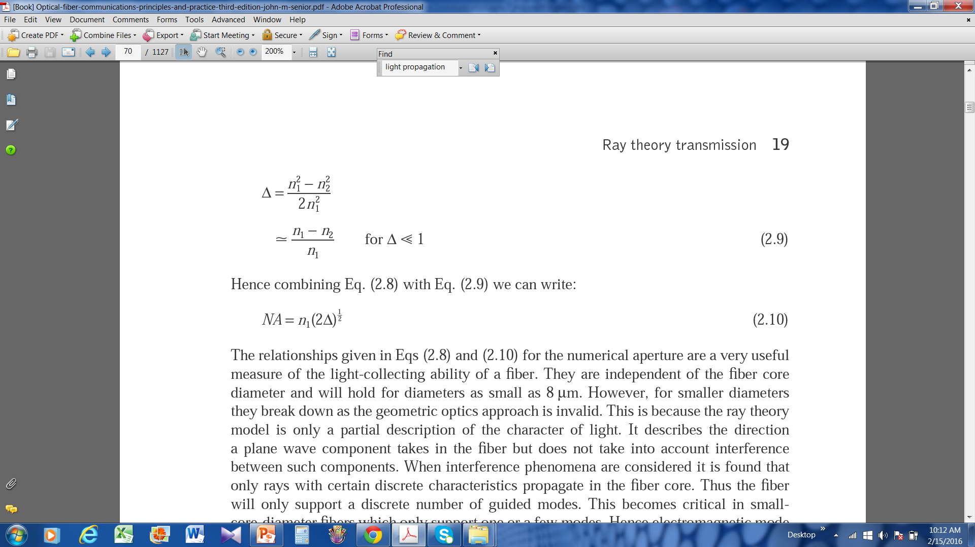
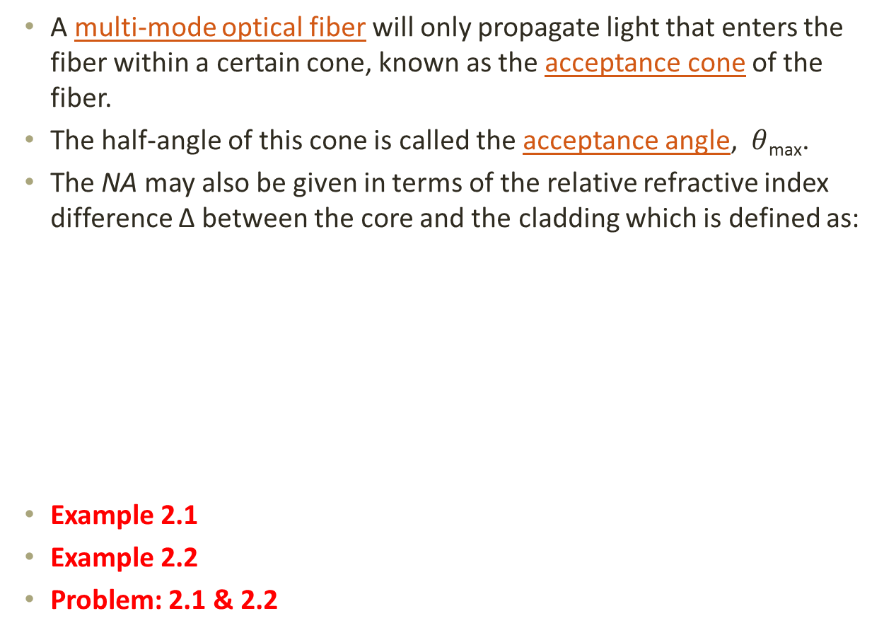
Numerical Aperture
A multi-mode optical fiber will only propagate light that enters the fiber within a certain cone, known as the acceptance cone of the fiber.
The half-angle of this cone is called the acceptance angle, $θ$_{max}.
The NA may also be given in terms of the relative refractive index difference Δ between the core and the cladding which is defined as:
Example 2.1
Example 2.2
Problem: 2.1 & 2.2

Slide 25
Electromagnetic mode theory
Electromagnetic waves:
Transmission of energy through a vacuum or using no medium is accomplished by electromagnetic waves, caused by the oscillation of electric and magnetic fields.
The electronic and magnetic fields oscillate in directions perpendicular to each other and to the direction of motion of the wave.
Both fields are mutually coupled vector waves and are vector functions of position & time.
http://www.science.uwaterloo.ca/~cchieh/cact/c120/emwave.html

Slide 26
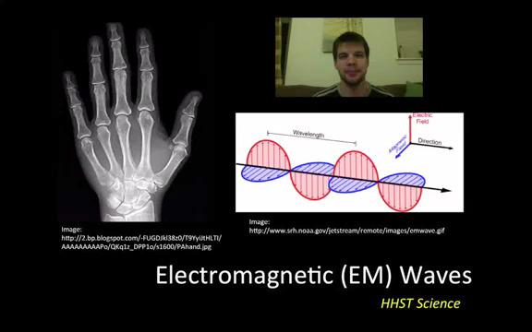

Slide 27
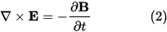
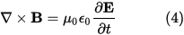
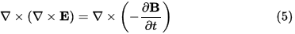
In free space, electric & magnetic fields satisfy the following partial differential equations, known as Maxwell’ equations:
Utilizing vector identities, which work for any vector, as follows:
The curl of equation (2):
https://en.wikipedia.org/wiki/Electromagnetic_radiation

Slide 28
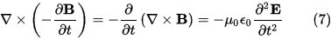
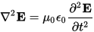
Evaluating the left hand side:
simplifying the above by using equation (1).
Evaluating the right hand side:
Equations (6) and (7) are equal, so this results in a vector-valued differential equation for the electric field, namely

Slide 29
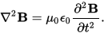
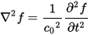
Applying a similar pattern results in similar differential equation for the magnetic field:
These differential equations are equivalent to the wave equation:
Where c₀ is the speed of the wave in free space and f describes a displacement

Slide 30
Modes in a planar guide:
A transverse mode of electromagnetic radiation is a particular electromagnetic field pattern of radiation measured in a plane perpendicular (i.e., transverse) to the propagation direction of the beam.
Transverse electric (TE)
Transverse magnetic (TM)
Transverse electromagnetic (TEM)
When light is described as an electromagnetic wave it consists of a periodically varying electric field E and magnetic field H which are orientated at right angles to each other.

Slide 31
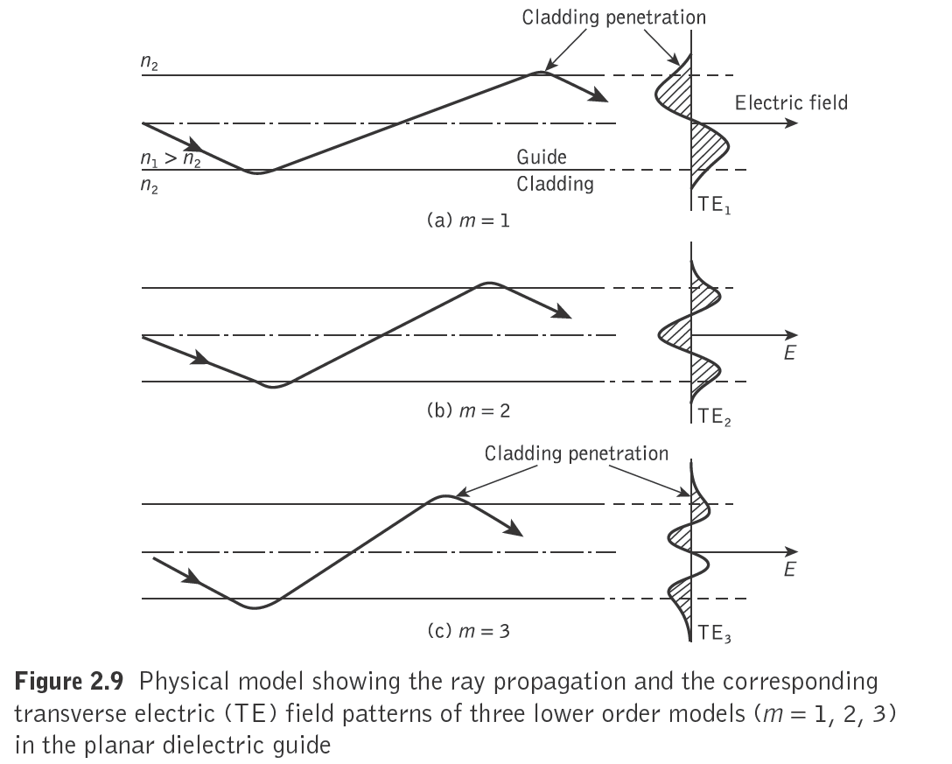

Slide 32
The transverse modes shown in Figure 2.9 illustrate the case when the electric field is perpendicular to the direction of propagation and hence Ez = 0, but a corresponding component of the magnetic field H is in the direction of propagation.
In this instance the modes are said to be transverse electric (TE).
Alternatively, when a component of the E field is in the direction of propagation, but Hz = 0, the modes formed are called transverse magnetic (TM).
When the total field lies in the transverse plane, transverse electromagnetic (TEM) waves exist where both Ez and Hz are zero.
However, although TEM waves occur in metallic conductors (e.g. coaxial cables) they are seldom found in optical waveguides.

Slide 33
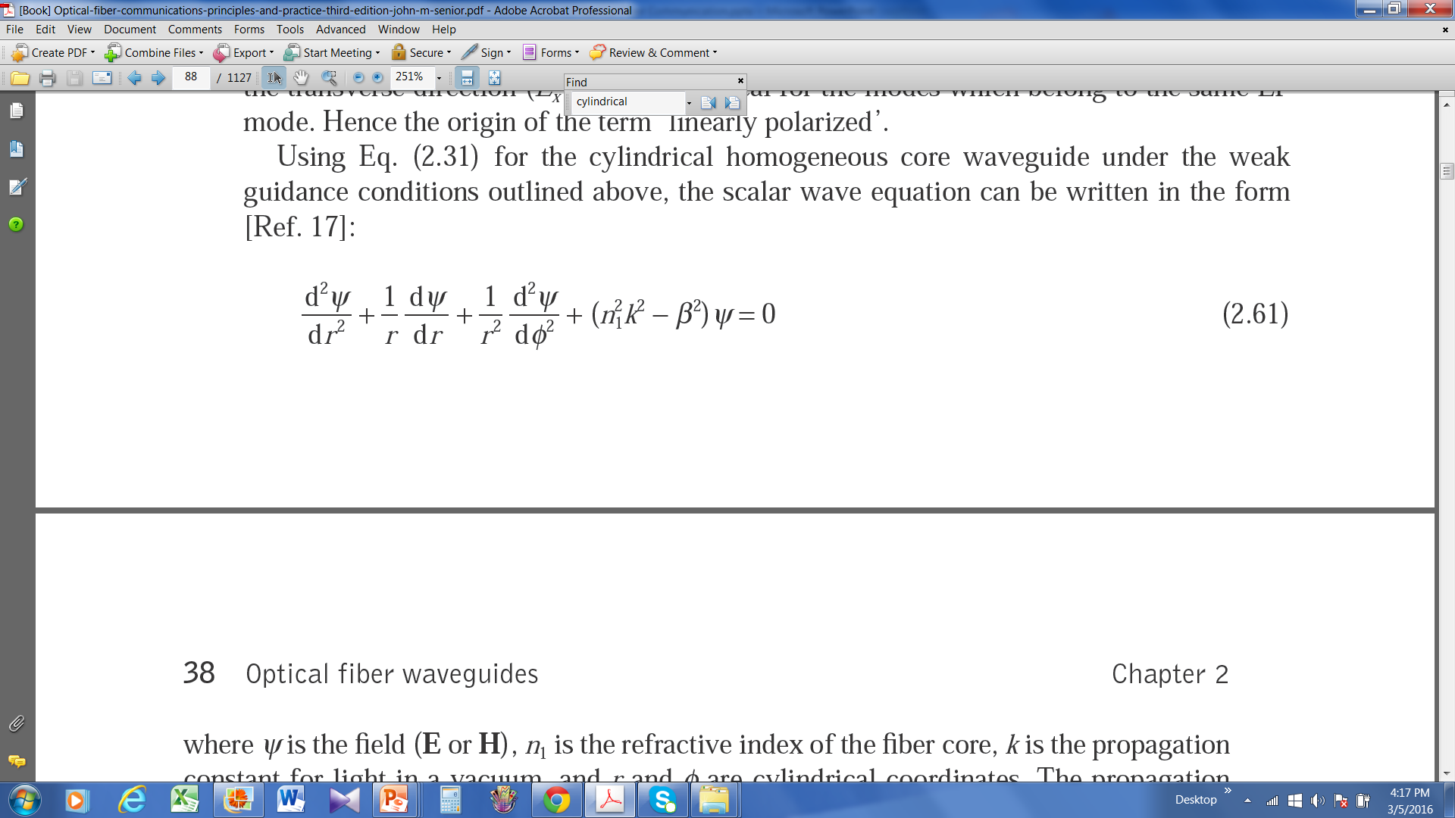
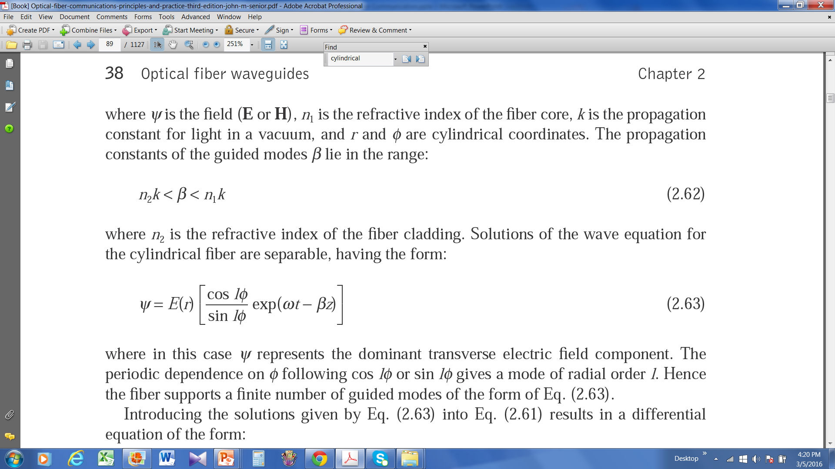
Cylindrical fiber
This type of optical waveguide with a constant refractive index core is known as a step index fiber.
The cylindrical homogeneous core waveguide under the weak guidance conditions, the scalar wave equation can be written in the form:
where ψ is the field (E or H), n₁ is the refractive index of the fiber core, k is the propagation constant for light in a vacuum, and r and φ are cylindrical coordinates.
The propagation constants of the guided modes β lie in the range:

Slide 34
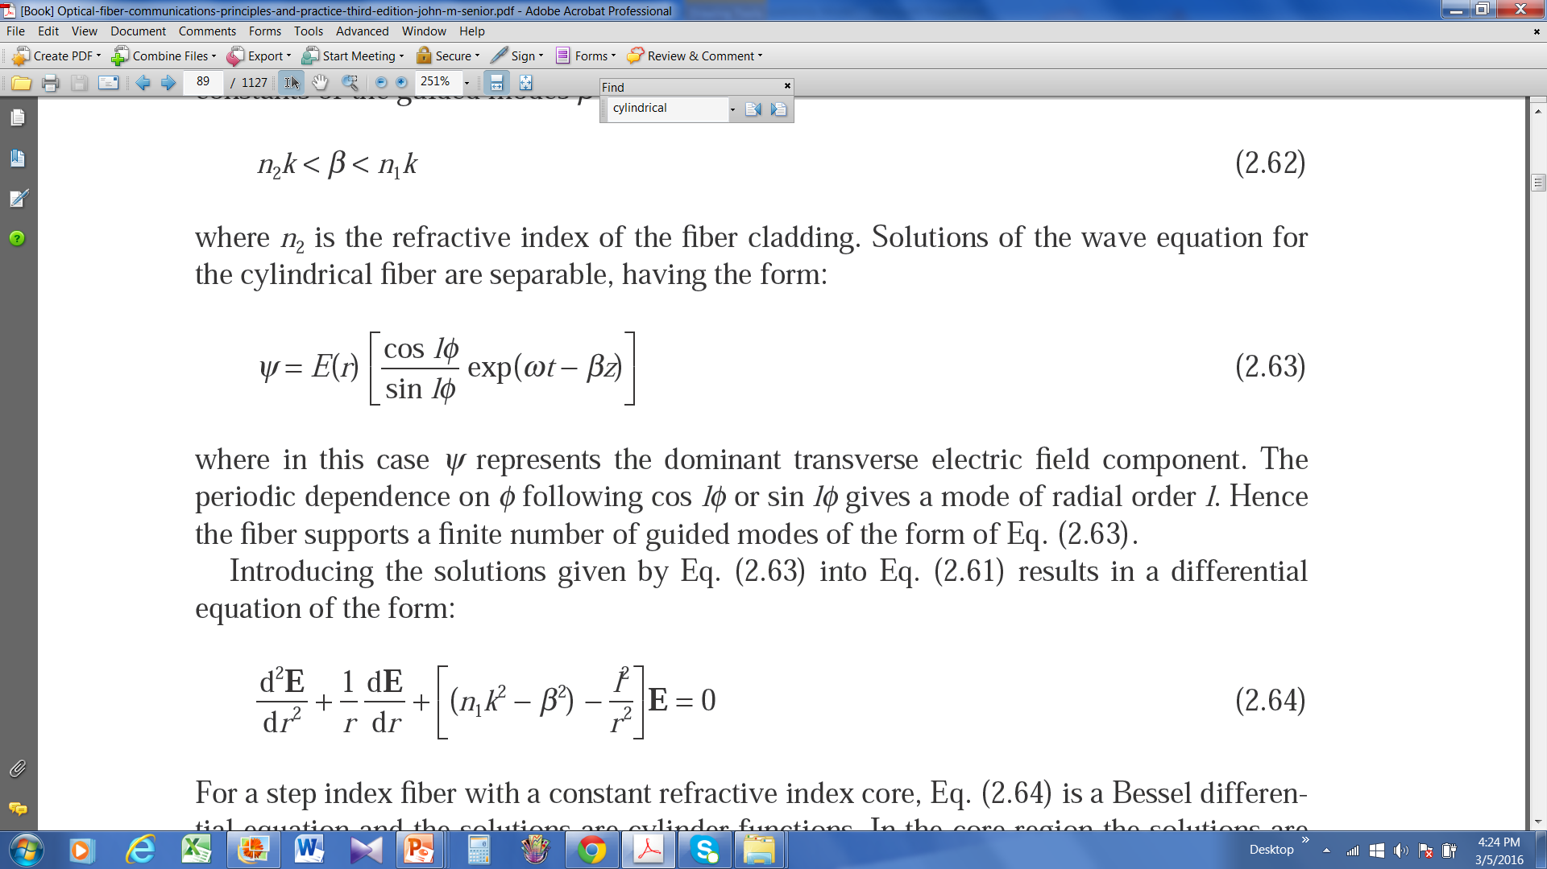
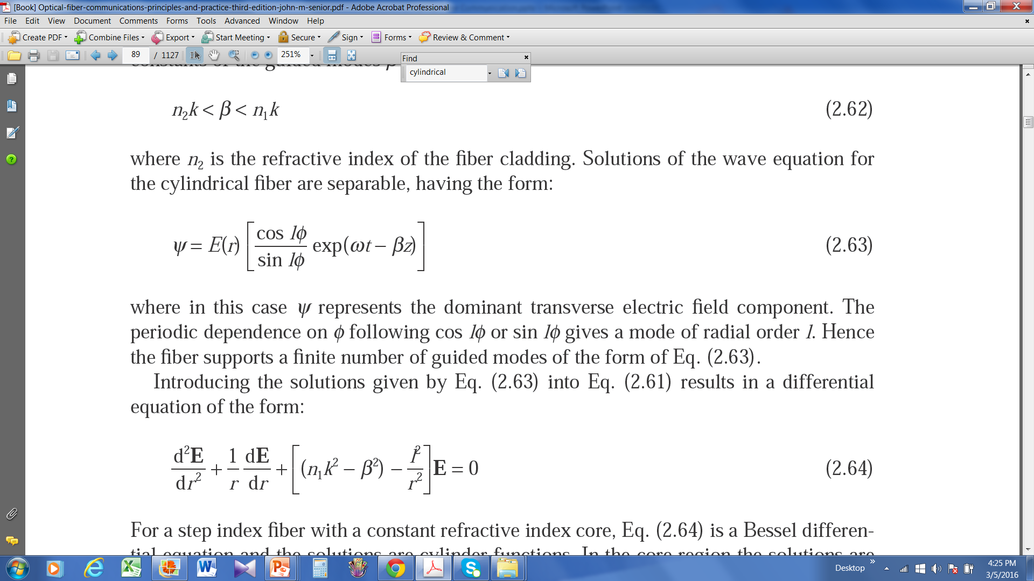
where n2 is the refractive index of the fiber cladding.
Solutions of the wave equation for the cylindrical fiber are separable, having the form:
where in this case ψ represents the dominant transverse electric field component. The periodic dependence on φ following cos lφ or sin lφ gives a mode of radial order l.
Hence the fiber supports a finite number of guided modes of the form of Eq. (2.63).
For a step index fiber with a constant refractive index core, Eq. (2.64) is a Bessel differential equation and the solutions are cylinder functions.

Slide 35
a is the radius of the fiber core; U and W, which are the eigenvalues in the core and cladding respectively.

Slide 36
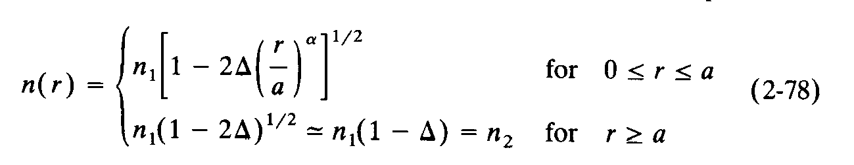
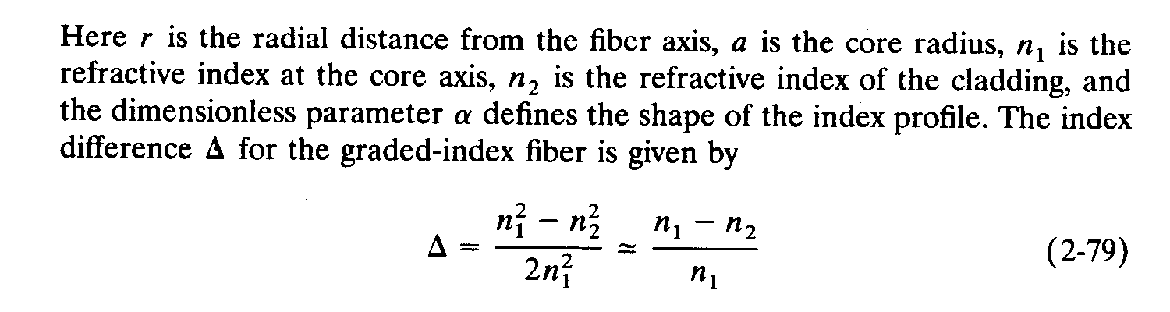
Graded index fibers
The core refractive index decreases continuously with increasing radial distance r from the center of the fiber but is generally constant in the cladding.
The refractive-index variation in the core follows the power law relationship:
Book: Keiser

Slide 37
For different values of alfha

Slide 38
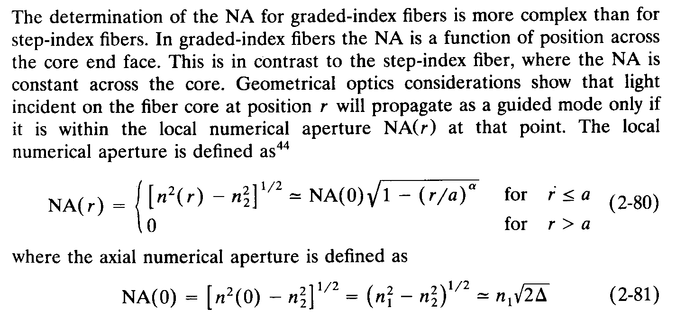
Graded Index Numerical Aperture
Example: 2.5
Book: Senior
Book: Keiser

Slide 39
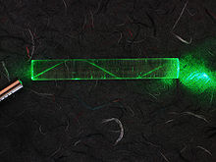
Single-mode fiber
Fiber supporting only one mode is called single-ode or mono-mode fiber.
In fiber-optic communication, a single-mode optical fiber (SMF) is an optical fiber designed to carry light only directly down the fiber.
Signle mode fibers are constructed by letting dimensions of the core diameter be a few wavelength and by having small index differences between the core and the cladding.

Slide 40
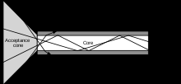
Multi-mode fiber
Fiber with large core diameter (greater than 10 micrometers) may be analyzed by geometrical optics. Such fiber is called multi-mode fiber, from the electromagnetic analysis.
Multi-mode optical fiber is a type of optical fiber mostly used for communication over short distances, such as within a building or on a campus.

Slide 42
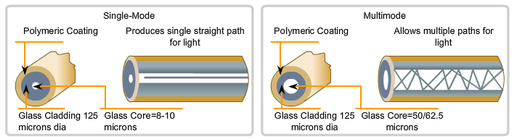
Single mode vs. Multimode Fibers
lipas.uwasa.fi/~TAU/AUTO3160/Slides/Miguel.pptx
Single-Mode | Multimode
Small core Less dispersion Carry a single ray of light, usually generated from a laser. Employ for long distance applications (100Km) Uses as Backbone and distances of several thousands meters. | Larger core than single mode cable. Allows greater dispersion and therefore, loss of signal. Used for shorter distance application, but shorter than single-mode (up to 2Km) It uses LED source that generates differtes angles along cable. Often uses in LANs or small distances such as campus networks.

Slide 43
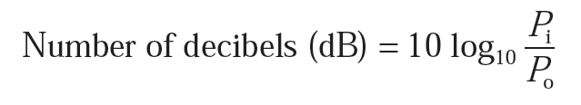
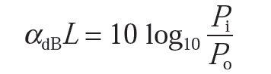
Attenuation
Attenuation -> transmission loss
The ratio of the input (transmitted) optical power P_{i} into a fiber to the output (received) optical power P_{o}:
In optical fiber communications the attenuation is usually expressed in decibels per unit length (i.e. dB km−1) following:
where α_{dB} is the signal attenuation per unit length in decibels which is also referred to as the fiber loss parameter and L is the fiber length.

Slide 44
Attenuation
Attenuation in optical fiber is caused by
Absorption (Intrinsic and extrinsic)
Scattering (Rayleigh and Mie)
Bending (Microbend and Macrobend)

Slide 45
Material absorption losses in silica glass fibers
Material absorption is a loss mechanism related to the material composition and the fabrication process for the fiber
Two types:
Intrinsic - interaction with one or more of the major components of the glass
Extrinsic - impurities within the glass
Intrinsic absorption:
An absolutely pure silicate glass has little intrinsic absorption due to its basic material structure in the near-infrared region.

Slide 46
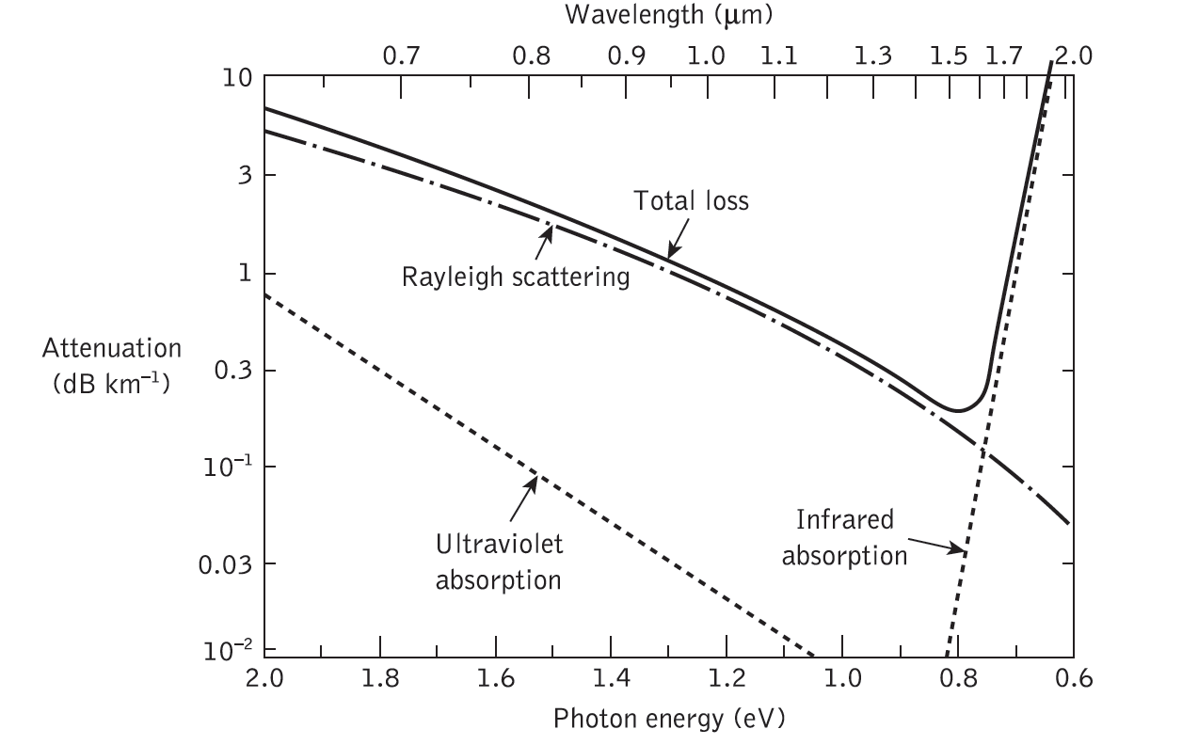

Slide 47
Linear scattering losses
One propagating mode to be transferred linearly into a different mode
Two major types:
Rayleigh and Mie scattering.
Rayleigh scattering:
Rayleigh scattering is the dominant intrinsic loss mechanism in the low-absorption window between the ultraviolet and infrared absorption tails.

Slide 48
The size of a scattering particle is often parameterized by the ratio
x=2πr/λ
where r is its characteristic length (radius) and λ is the wavelength of the light.
Rayleigh scattering applies to the case when the scattering particle is very small (x ≪ 1, with a particle size < 1/10 wavelength^{[4]}) and the whole surface re-radiates with the same phase.

Slide 49
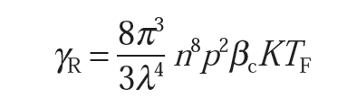
In optical fiber, for a single-component glass this is given by:
where γ_{R} is the Rayleigh scattering coefficient, λ is the optical wavelength, n is the refractive index of the medium, p is the average photoelastic coefficient, β_{c} is the isothermal compressibility at a fictive temperature T_{F}, and K is Boltzmann’s constant.
The fictive temperature is defined as the temperature at which the glass can reach a state of thermal equilibrium and is closely related to the anneal temperature.

Slide 50
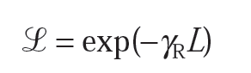
Furthermore, the Rayleigh scattering coefficient is related to the transmission loss factor (transmissivity) of the fiber following the relation:
where L is the length of the fiber.
Example 3.1
Example 3.2

Slide 51
Mie scattering:
The scattering created by inhomogeneities is called Mie scattering. Depending upon the fiber material, design and manufacture, Mie scattering can cause significant losses.
The inhomogeneities may be reduced by:
(a) removing imperfections due to the glass manufacturing process;
(b) carefully controlled extrusion and coating of the fiber;
(c) increasing the fiber guidance by increasing the relative refractive index difference.

Slide 52
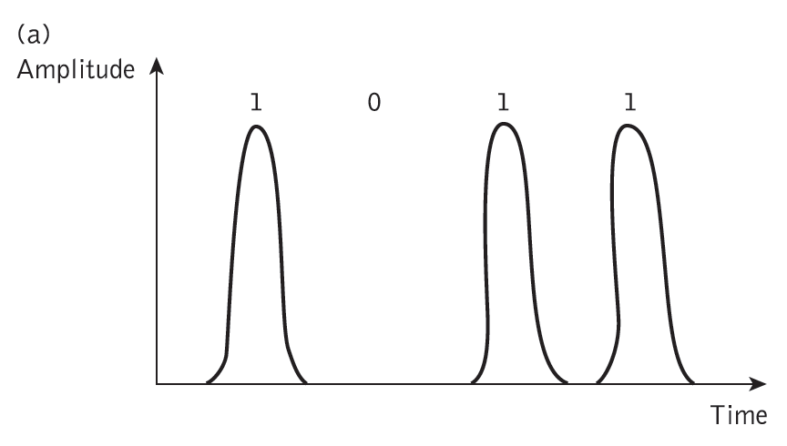
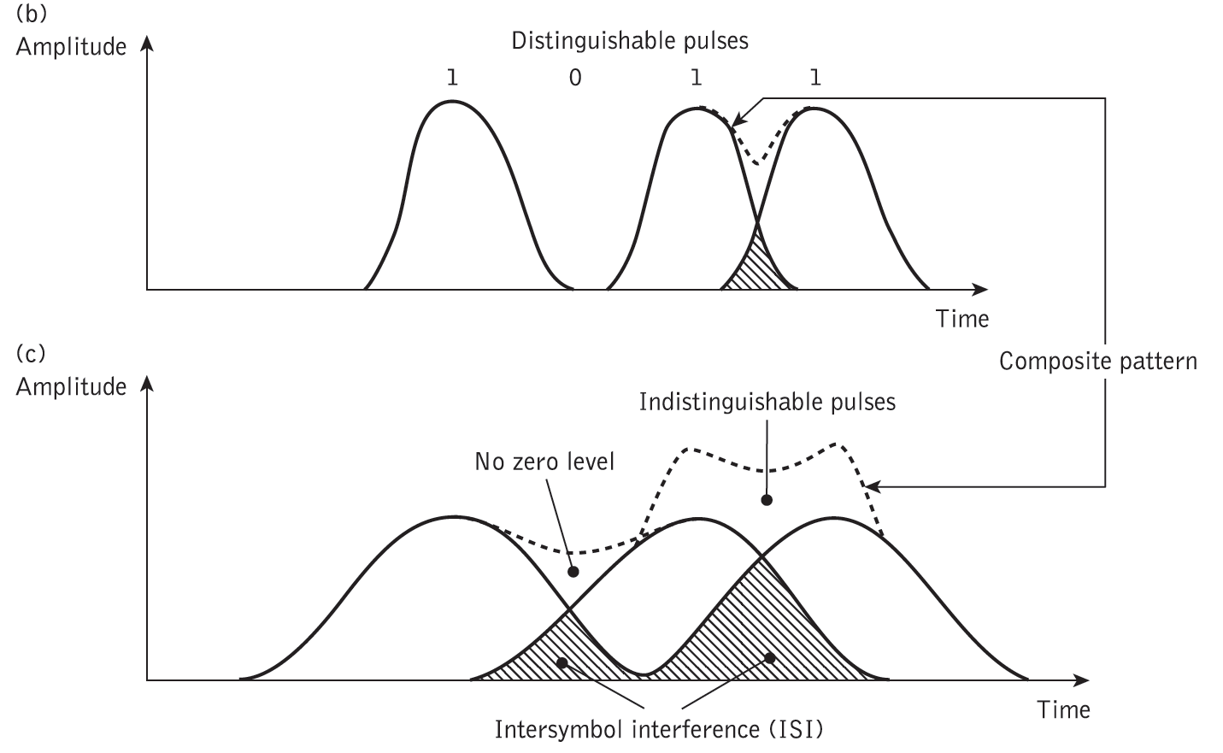
Dispersion
Dispersion of the transmitted optical signal causes distortion for both digital and analog transmission along optical fibers.
Intermodal dispersion
Intra-modal dispersion
Material dispersion
Waveguide dispersion

Slide 53
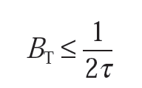
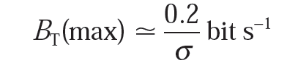
For no overlapping of light pulses down on an optical fiber link the digital bit rate B_{T} must be less than the reciprocal of the broadened (through dispersion) pulse duration (2τ).
This is the conservative estimate.
The maximum bit rate is given approximately by considering the light pulses at the output to have a Gaussian shape with an rms width of σ.
Example 3.5

Slide 54
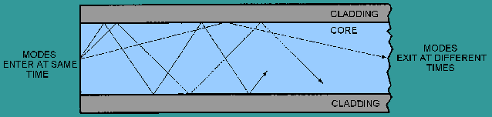
Intermodal dispersion
Results from the propagation delay difference between modes
Modes of light pulses that enter the fiber at one time, exit the fiber at different times
pulse width at the output is dependent upon the transmission times of the slowest and fastest order modes

Slide 55
Intra-modal or chromatic dispersion
Optical source emits a band of frequencies
This type of dispersion depends primarily on fiber materials
Different spectral components travel trough different materials and different waveguide structures at different speeds
There are two types of chromatic dispersion (material dispersion and waveguide dispersion)
Material dispersion is a function of the spectral width.
WD occurs because propagation constant is a function of the wavelength of operation

Slide 56
Introduction
The optical source is an optical fiber communication system.
It converts electrical energy into optical energy (light).
Three main types of optical light source are available. These are:
(a) wideband ‘continuous spectra’ sources
(b) monochromatic incoherent sources (light-emitting diodes, LEDs);
(c) monochromatic coherent sources (lasers).

Slide 57
Major requirements for an optical source
1. A size and configuration compatible with launching light into an optical fiber. Ideally, the light output should be highly directional.
2. Must accurately track the electrical input signal to minimize distortion and noise. Ideally, the source should be linear.
3. Should emit light at wavelengths where the fiber has low losses and low dispersion and where the detectors are efficient.
4. Preferably capable of simple signal modulation over a wide bandwidth extending from audio frequencies to beyond the gigahertz range.

Slide 58
5. Must couple sufficient optical power to overcome attenuation in the fiber plus additional connector losses and leave adequate power to drive the detector.
6. Should have a very narrow spectral bandwidth (linewidth) in order to minimize dispersion in the fiber.
7. Must be capable of maintaining a stable optical output which is largely unaffected by changes in ambient conditions (e.g. temperature).
8. It is essential that the source is comparatively cheap and highly reliable in order to compete with conventional transmission techniques.

Slide 59
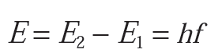
Basic Principle
Absorption and emission of radiation:
The interaction of light with matter takes place in discrete packets of energy, called photons.
According to the quantum theory, atoms exist only in certain discrete energy states such that absorption and emission of light causes them to make a transition from one discrete energy state to another.
The frequency of the absorbed or emitted radiation f is expressed by:
where h = 6.626 × 10⁻³⁴ J.s is Planck’s constant.

Slide 60
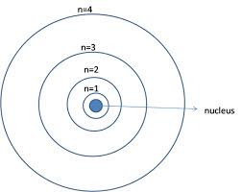
Different energy states -> different electron configurations.
Single electron transition between two energy levels within the atom will provide a change in energy suitable for the absorption or emission of a photon.

Slide 61
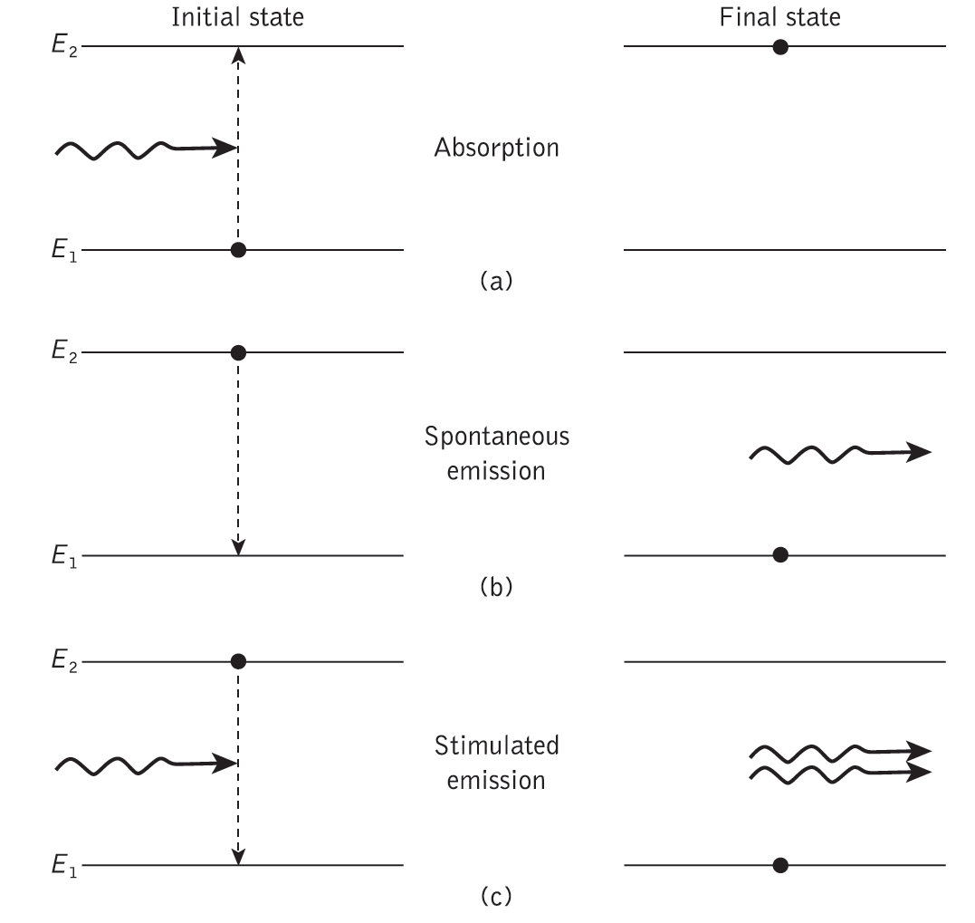

Slide 62
The emission process can occur in two ways:
(a) by spontaneous emission in which the atom returns to the lower energy state in an entirely random manner;
(b) by stimulated emission when a photon having an energy equal to the energy difference between the two states (E₂ − E₁) interacts with the atom in the upper energy state causing it to return to the lower state with the creation of a second photon.

Slide 63
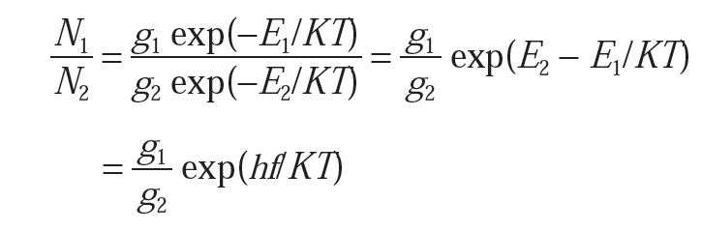
The Einstein relations
Einstein mathematically demonstrated that the rates of absorption, spontaneous emission and stimulated emission were thermal equilibrium.
the rate of the upward transitions must equal the rate of the downward transitions.
The population of the two energy levels of such a system is described by Boltzmann statistics which give:
where N₁ and N₂ represent the density of atoms in energy levels E₁ and E₂, respectively, with g₁ and g₂ being the corresponding degeneracies of the levels, K is Boltzmann’s constant and T is the absolute temperature.
(6.2)

Slide 64
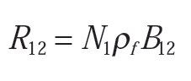
Absorption rate:
Density of atoms in the lower energy state is N₁,
the spectral density ρ_{f} of the radiation energy at the transition frequency f.
the upward transition or absorption rate R₁₂ (indicating an electron transition from level 1 to level 2) may be written as:
where the constant of proportionality B₁₂ is known as the Einstein coefficient of absorption.

Slide 65
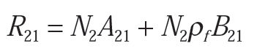
The rate of stimulated downward transition:
the rate of stimulated emission is given by N₂ρ_{f} B₂₁, where B₂₁ is the Einstein coefficient of stimulated emission.
The total transition rate from level 2 to level 1, R₂₁, is the sum of the spontaneous and stimulated contributions. Hence:
Where A₂₁, the Einstein coefficient of spontaneous emission, is equal to the reciprocal of the spontaneous lifetime.
A₂₁ = 1/τ₂

Slide 66
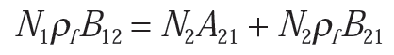



For a system in thermal equilibrium, the upward and downward transition rates must be equal and R₁₂ = R₂₁,:
Substituting Eq. (6.2) into Eq. (6.6) gives:
and
(6.6)
(6.7)

Slide 67




According to Planck spectral density
(6.8)
Comparing Eq. (6.8) with Eq. (6.7) we obtain the Einstein relations:
and
Example 6.1
The ratio of the stimulated emission rate is given by:

Slide 68

Threshold condition for laser oscillation
Threshold gain within the amplifying medium must be attained such that laser oscillations are initiated and sustained.
This threshold gain may be determined by considering the change in energy of a light beam as it passes through the amplifying medium.
Hence the fractional loss incurred by the light beam is:
single loss coefficient per unit length, α cm−1.
medium length L
the two mirrors which have reflectivities r₁ and r₂.

Slide 69




Therefore if the gain coefficient per unit length produced
by stimulated emission is , the fractional round trip gain is given by:
Hence:
and:
After rearranging the above expression
The second term on the right hand side of Eq. (6.20) represents the transmission loss through the mirrors
Example 6.3
(6.20)

Slide 70
Semiconductor materials
The semiconductor materials used for optical sources must broadly fulfill several criteria.
These are as follows:
1. p–n junction formation. The materials must lend themselves to the formation of p–n junctions with suitable characteristics for carrier injection.
2. Efficient electroluminescence. The devices fabricated must have a high probability of radiative transitions.
3. Useful emission wavelength. The materials must emit light at a suitable wavelength to be utilized with current optical fibers and detectors (0.8 to 1.7 μm).

Slide 71
The semiconductor injection laser
Major advantages over other semiconductor sources (e.g. LEDs) that may be used for optical communications. These are as follows:
1. High radiance due to the amplifying effect of stimulated emission.
2. Narrow linewidth on the order of 1 nm (10 Å) or less which is useful in minimizing the effects of material dispersion.
3. Modulation capabilities which at present extend up into the gigahertz range and will undoubtedly be improved.
4. Relative temporal coherence which is considered essential to allow heterodyne (coherent) detection in high-capacity systems.
5. Good spatial coherence which allows the output to be focused by a lens into a spot.

Slide 72




Efficiency
the total efficiency (external quantum efficiency) η_{T} which is
efficiency defined as:
The external power efficiency of the device (or device efficiency) η_{ep} in converting electrical input to optical output is given by:
where P = IV is the d.c. electrical input power.
Using Eq. (6.39) for the total efficiency we find:
Example 6.5

Slide 73
LED Laser
When conduction band electrons recombine with holes in the valence band, photons are emitted.
This is the mechanism by which light is emitted from an LED.
The LED can therefore operate at lower current densities than the injection laser.
But the emitted photons have random phases and the device is an incoherent optical source.
the energy of the emitted photons is only roughly equal to the bandgap energy of the semiconductor material

Slide 74
LEDs have several drawbacks in comparison with injection lasers. These include:
(a) generally lower optical power coupled into a fiber (microwatts);
(b) usually lower modulation bandwidth;
(c) harmonic distortion.

Slide 75
Advantages of LED:
1. Simpler fabrication. There are no mirror facets and in some structures no striped
geometry.
2. Cost. The simpler construction of the LED leads to much reduced cost.
3. Reliability. The LED does not exhibit catastrophic degradation and has proved far less sensitive to gradual degradation than the injection laser.
4. Generally less temperature dependence. The light output against current characteristic is less affected by temperature. The LED is not a threshold device and therefore raising the temperature does not increase the threshold current above the operating point and hence halt operation.

Slide 76
5. Simpler drive circuitry. Generally lower drive currents and reduced
temperature dependence which makes temperature compensation circuits unnecessary.
6. Linearity. Ideally, the LED has a linear light output against current characteristic.

Slide 77


LED power and efficiency
When there is a constant current flow into the junction diode, an equilibrium condition is established.
Hence a rate of carrier recombination can be expressed in the form:
(1)
The condition for equilibrium is obtained by setting the derivative in Eq. (1) to zero. Hence:
(2)
the total carrier recombination lifetime.

Slide 78



It is also apparent from Eq. (1) that in the steady state the total number of carrier recombinations per second or the recombination rate r_{t} will be:
where r_{r} = radiative recombination rate per unit volume and r_{nr} = nonradiative recombination rate per unit volume.
The total number of recombinations per second R_{t} becomes:
(3)
(4)
(5)
forward-biased current = i

Slide 79




The LED internal quantum efficiency η_{int}, which can be defined as the ratio of the radiative recombination rate to the total recombination rate, following Eq. (4) may be written as:
where R_{t} is the total number of radiative recombinations per second. Rearranging Eq. (6) and substituting from Eq. (5) gives:
Since R_{r} = the total number of photons generated per second and each photon has an energy equal to hf joules, then the optical power generated internally by the LED, P_{int}, is:
(6)
(7)
(8)

Slide 80




Power in terms of wavelength rather than frequency gives:
Therefore, from Eq. (6) the internal quantum efficiency is:
Furthermore, the total recombination lifetime τ can be written as τ = Δn/r_{t} which, using Eq. (7.5), gives:
Hence Eq. (10) becomes:
(9)
the radiative minority carrier lifetime is τ_{r} = Δn/r_{r} and
the nonradiative minority carrier lifetime is τ_{nr} = Δn/r_{nr}.
(10)
(11)
Example 7.1, 7.2

Slide 81
Optical Detector
It converts the received optical signal into an electrical signal, which is then amplified before further processing.
Device types:
In the near-infrared region -> both external and internal photoemission of electrons may be utilized.
External photoemission devices -> photomultiplier tubes and vacuum photodiodes; bulky, and require high voltages.
Internal photoemission devices -> semiconductor photodiodes with or without internal (avalanche) gain; good performance and compatibility with relatively low cost.
Now, p–i–n and avalanche photodiodes (small wavelength regions 0.8 to 0.9 μm, 1.3 μm and 1.55 μm).

Slide 82

The p–i–n photodiode
The n-type material is doped so lightly that it can be considered intrinsic, and to make a low resistance contact a highly doped n-type (n⁺) layer is added.
$E_{ph}=\frac{hc}{λ}$
Photon energy is inversely proportional to the wavelength.
The wavelength at which the photon energy = Band gap energy; Called cut off wavelength .
Photon energy>Band gap energy

Slide 83

This creates a p–i–n (or PIN) structure, where all the absorption takes place in the depletion region.
Under strong electric field that was generated by reverse bias potential difference across the device – photo current is formed and the intensity is proportional to the number of incident photons.

Slide 84

two types of silicon p–i–n photodiode for operation in the shorter wavelength band below 1.09 μm.
The front-illuminated photodiode-> operating in the 0.8 to 0.9 μm band, depletion region 20-50 μm, high quantum efficiency (typically 85%), response time <1 ns and low dark current (1 nA).
Dark current arises from surface leakage currents as well as generation–recombination currents in the depletion region in the absence of illumination.

Slide 85

The side-illuminated structure -> light is injected parallel to the junction plane, exhibits a large absorption width (500 μm) and sensitive at wavelengths ~ bandgap limit (1.09 μm) where the absorption coefficient is relatively small.

Slide 86
Detector Noise
The overall sensitivity of a photodiode results from the random current and voltage fluctuations which occur at the device output terminals in both the presence and absence of an incident optical signal.
The noise performance of optical detectors are: the noise equivalent power (NEP); the detectivity (D); and the specific detectivity (D*).
The NEP is defined as the incident optical power, at a particular wavelength, required to produce a photodetector current equal to the rms noise current within a unit bandwidth (i.e. B = 1 Hz).

Slide 87




the output photocurrent is:
the photocurrent I_{p} equal to the rms shot noise current:
Moreover, the photodiode average current Ῑ may be represented by (I_{p} + I_{d}) where I_{d} is the dark current within the device. Hence:
Where, the energy of a photon E = hf.
I_{p} is the output photocurrent (A) and P_{o} is the incident optical power (W)
e is the charge on an electron.
photodiode received bandwidth=B
When I_{p} ≫ I_{d}, then:

Slide 88




Substituting Eq. (8.23) into Eq. (8.20) and putting B = 1 Hz gives the NEP as:
This is the NEP for an ideal photodetector when the quantum efficiency η = 1.
When I_{p} ≪ I_{d}, then the photocurrent becomes:
When the dark current noise is dominant, with B = 1 Hz gives an expression for the NEP of:
The detectivity D is defined as the inverse of the NEP. Thus:
Example 8.6

Slide 89
Preparation of optical fibers
This is a two-stage process:
Initially the pure glass is produced and converted into a form (rod or preform) suitable for making the fiber.
A drawing or pulling technique is then employed to acquire the end product.
The methods of preparing the extremely pure optical glasses:
(a) conventional glass refining techniques in which the glass is processed in the molten state producing a multicomponent glass structure;
(b) vapor-phase deposition methods producing silica-rich glasses which have melting temperatures that are too high to allow the conventional melt process.
vapor-phase methods are widely used.

Slide 90
Optical fiber cables
The functions of the optical cable:
1. Fiber protection -> to protect against fiber damage and breakage both during installation and throughout the life of the fiber.
2. Stability of the fiber transmission characteristics -> must have good stable transmission characteristics. Increases in optical attenuation.
3. Cable strength -> similar mechanical properties to electrical transmission cables such as tension, torsion, compression, bending, squeezing and vibration.
4. Identification and jointing of the fibers within the cable -> If the fibers are arranged in a suitable geometry it may be possible to use multiple jointing techniques rather than jointing each fiber individually.

Slide 91
Fiber splices
A permanent joint formed between two individual optical fibers in the field or factory is known as a fiber splice.
Splices may be divided into two broad categories depending upon the splicing technique utilized. These are fusion splicing or welding and mechanical splicing.
Fusion splicing-> by applying localized heating at the interface between two butted, prealigned fiber ends causing them to soften and fuse.
Mechanical splicing-> held in alignment by some mechanical means, such as use of tubes around the fiber ends (tube splices).

Slide 92


Slide 93
Fiber connectors
Demountable fiber connectors are more difficult to achieve than optical fiber splices.
This is because they must maintain similar tolerance requirements to splices in order to couple light between fibers efficiently, but they must accomplish it in a removable fashion.
Also, the connector design must allow for repeated connection and disconnection without problems of fiber alignment.
In order to maintain an optimum performance the connection must also protect the fiber ends from damage.

Slide 94
Optical fiber connectors may be considered in three major areas, which are:
(a) the fiber termination, which protects and locates the fiber ends;
(b) the fiber end alignment to provide optimum optical coupling;
(c) the outer shell, which maintains the connection and the fiber alignment, protects the fiber ends from the environment and provides adequate strength at the joint.

Slide 95
Fiber couplers
An optical fiber coupler is a device that distributes light from a main fiber into one or more branch fibers.*
The latter case is more normal and such devices are known as multiport fiber couplers.
Optical fiber couplers are often passive devices in which the power transfer takes place either:
(a) through the fiber core cross-section by butt jointing the fibers or
(b) through the fiber surface and normal to its axis by converting the guided core modes to both cladding and refracted modes which then enable the power-sharing mechanism (surface interaction type).

Slide 96


Slide 97
Multiport optical fiber couplers can also be subdivided into the following three main groups, as illustrated in Figure 5.27.
1. Three- and four-port* couplers, which are used for signal splitting, distribution and combining.
2. Star couplers, which are generally used for distributing a single input signal to multiple outputs.
3. Wavelength division multiplexing (WDM) devices, which are a specialized form of coupler designed to permit a number of different peak wavelength optical signals to be transmitted in parallel on a single fiber.

Slide 98



Slide 99
Integrated optics (IO)
Integrated optics (IO) -> optical and electro-optical elements integrated together and, recently, integrated photonics (IP).
IP refers to the fabrication and integration of several or many components onto a single planar substrate.
Such components include beam splitters, couplers, gratings, polarization controllers, interferometers, sources, detectors and optical amplifiers.
A complete system onto a single chip.
Planar waveguides are fundamental elements for both IO and IP device technologies.

Slide 100

Beam Splitter
Beam splitters are a basic element of many optical fiber communication systems often providing a Y-junction by which signals from separate sources can be combined, or the received power divided between two or more channels.
A

